Slide 1
Kansas FFA Discussion Meet
Sponsored & Facilitated by Kansas Farm Bureau

Slide 2
[Insert Mock Discussion Topic]
Notes:
Insert a topic to discuss that relates to the audience.
Ask for 4 volunteers. Give each a prompt, such as:
Topic: How can local schools and organizations like FFA better support career and technical education teachers with 5 or fewer years of experience?
Why is this topic important to you?
Why is this topic important to the audience?
Provide a statistic (real or made up) about teachers with 5 years of experience of less.
Tell a brief story about your first year of teaching that made you question whether you could do this job long-term.
As each volunteer to address the prompt on their card in front of the group. – once finished, talk about this being a glimpse at DM opening statements (grab the audience’s attention, demonstrate the participant is knowledgeable about the topic, etc.)
Next, ask the group to talk about the topic with each other. Give them 5 minutes or enough time for everyone to say one or two things.
Ask one person to summarize the conversation for the audience. (in the competition everyone will have to provide a summary)
Explain that this is a basic example of what happens in a discussion meet.

Slide 3
Why?

Slide 4
Why?
Investment in students and future leaders.
Logical Thinking & Analysis Skills
Communication Skills – prepared, conversational, extemporaneous
Problem Solving Skills
Conflict & Discourse Skills
Engage FFA members in conversations about important topics for today’s agriculture industry
Helps preserve a collaborative environment for the future of agriculture.
Further builds pipeline from FFA to KFB membership.
Encourages greater FFA chapter/county Farm Bureau relationships.

Slide 5
What is the Discussion Meet?

Slide 6
Individual Competition. Group Activity.

Slide 7
Competition Setup
Key
Participant
Judge
Moderator
Timekeeper
Spectator
Table

Slide 8
Participants Demonstrate Ability To:
Introduce the topic
Analyze the problem
Identify solutions
Think critically
Engage others effectively
Summarize discussion accurately

Slide 9
What Will Students Talk About?
Crops
Livestock
Natural Resources
Ag Education
FFA
Notes:
One topic within each of these categories/year.

Slide 10
Flow of Competition
Welcome & Introduction by Moderator
30-Second Opening Statements by each Participant
15-Minute Discussion by Participants
1-Minute Silence for Development of Closing Statements
1-Minute Closing Statements by each Participant
Dismissal of Judges to Tabulation Room
Participant Self-Introductions
Announcement of Next Round Topic

Slide 11
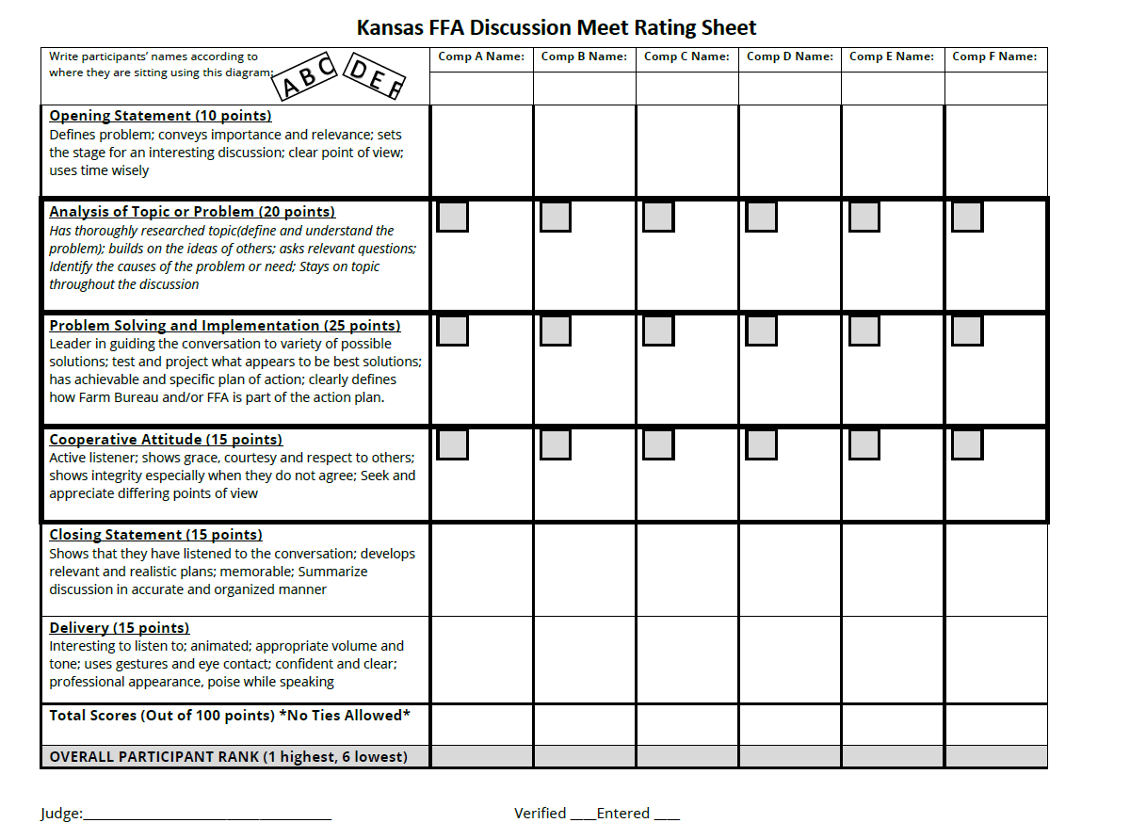
Rating Sheet

Slide 12
Preparing Students

Slide 13
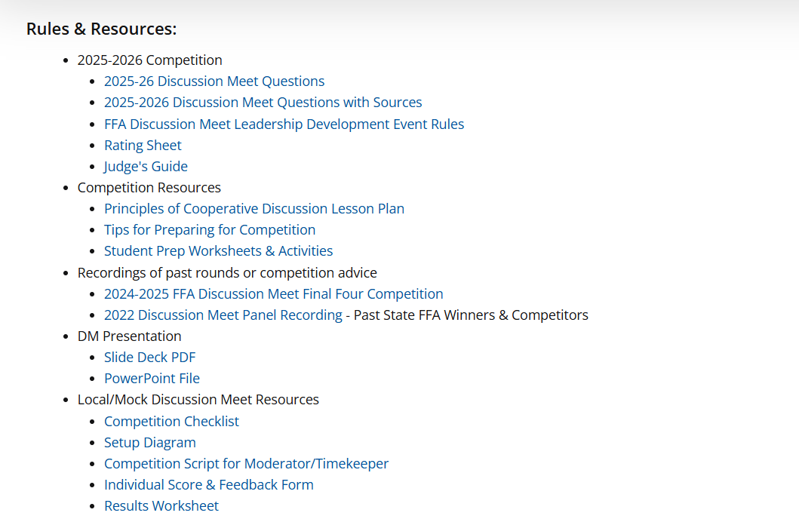
WWW.KFB.ORG/FFA

Slide 14
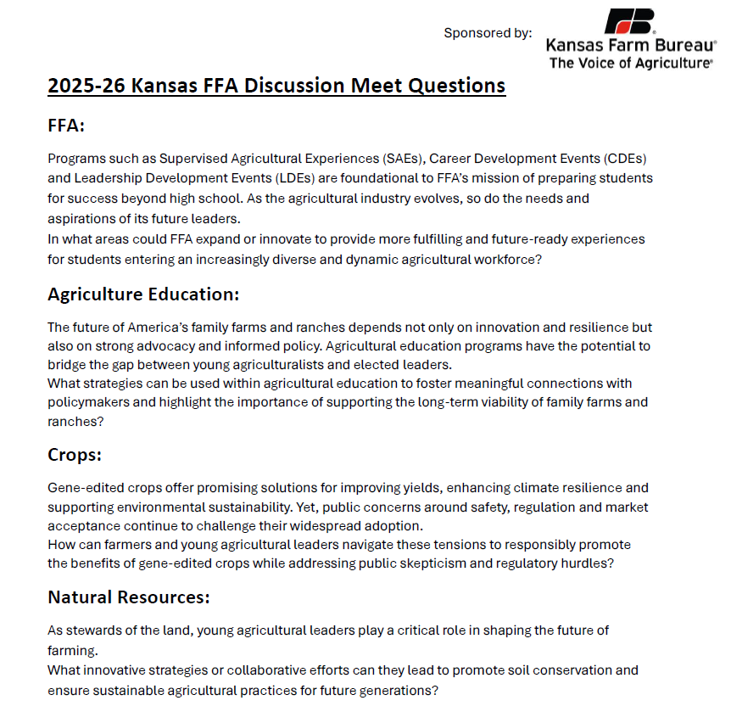
Topic Resources

Slide 15
Principles of Cooperative Discussion
A lesson plan for agricultural education teachers to use for:
Leadership development (critical thinking, active listening, collaboration, etc.)
Discussing hot topics in agriculture
Introducing the Discussion Meet

Slide 16
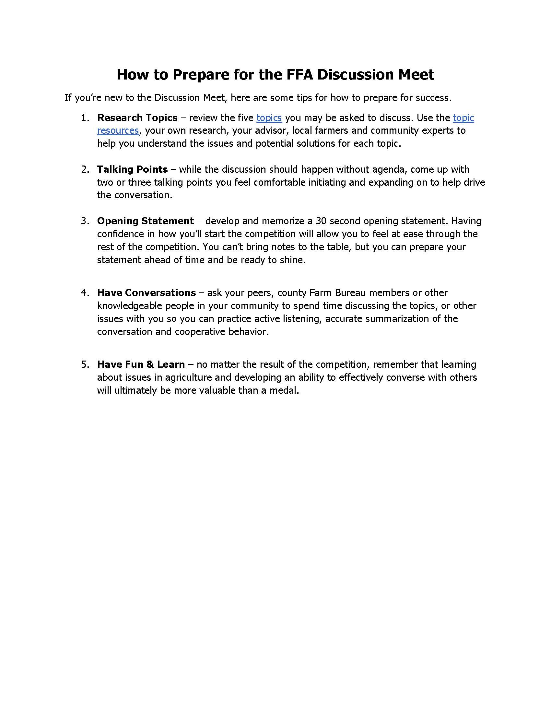
Preparation Tips

Slide 17
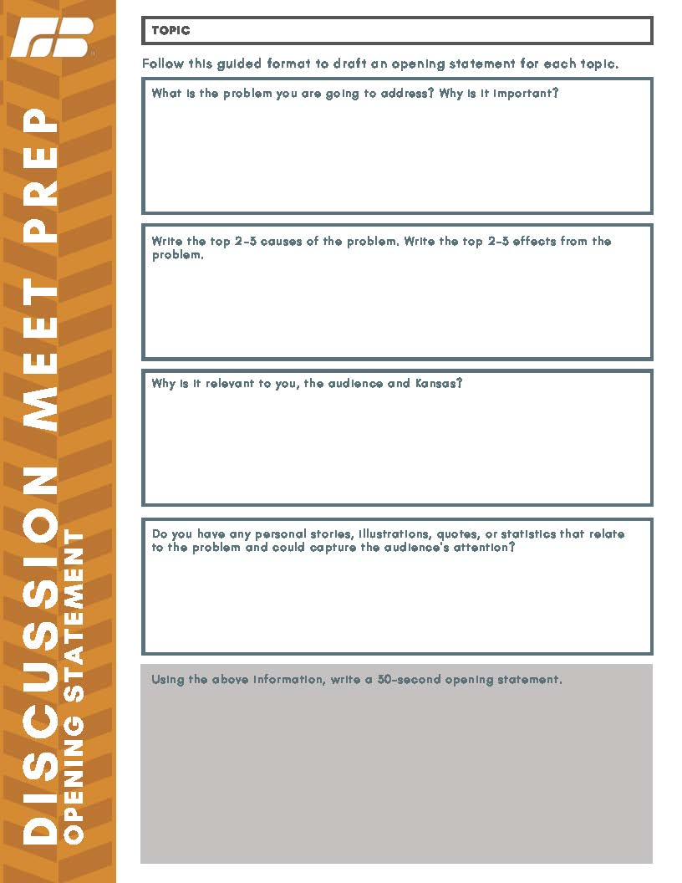
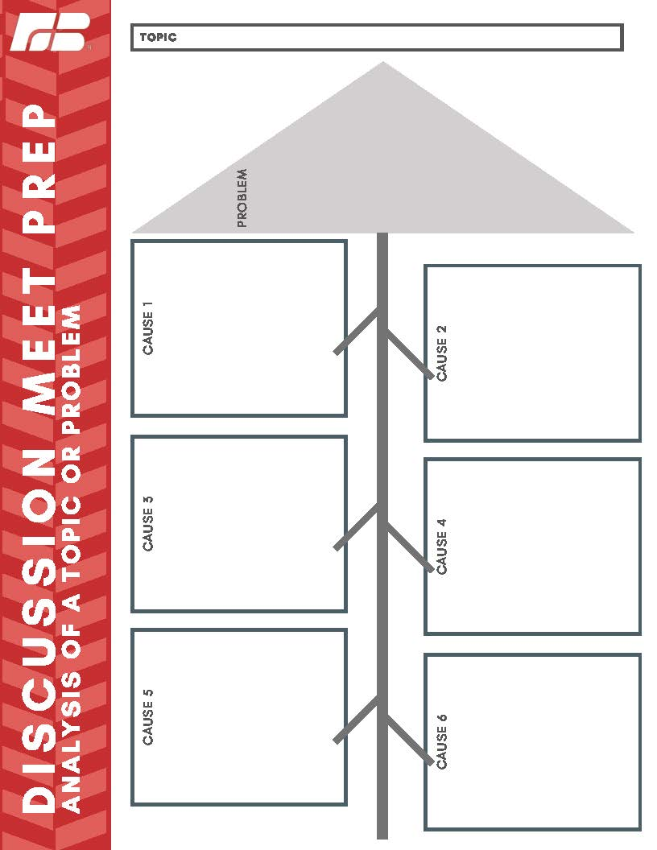
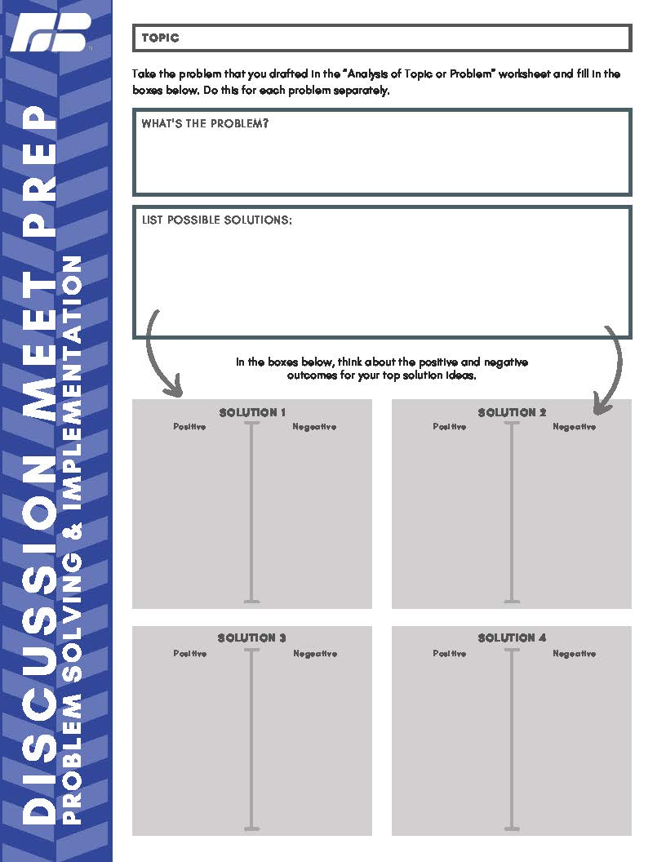
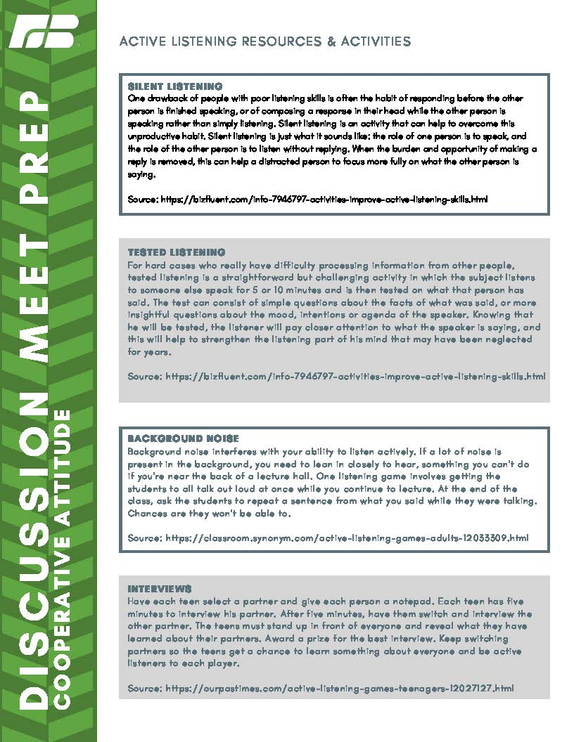
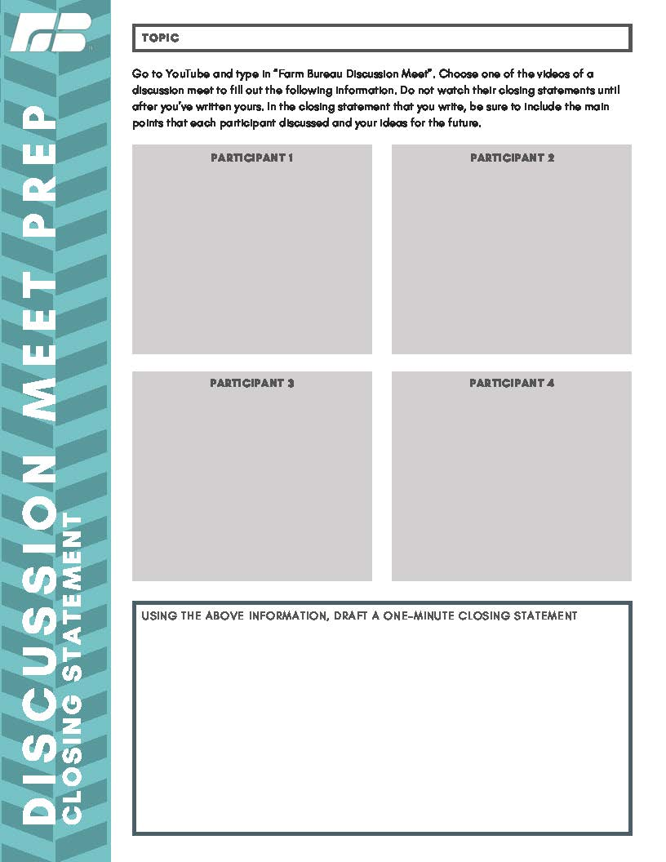
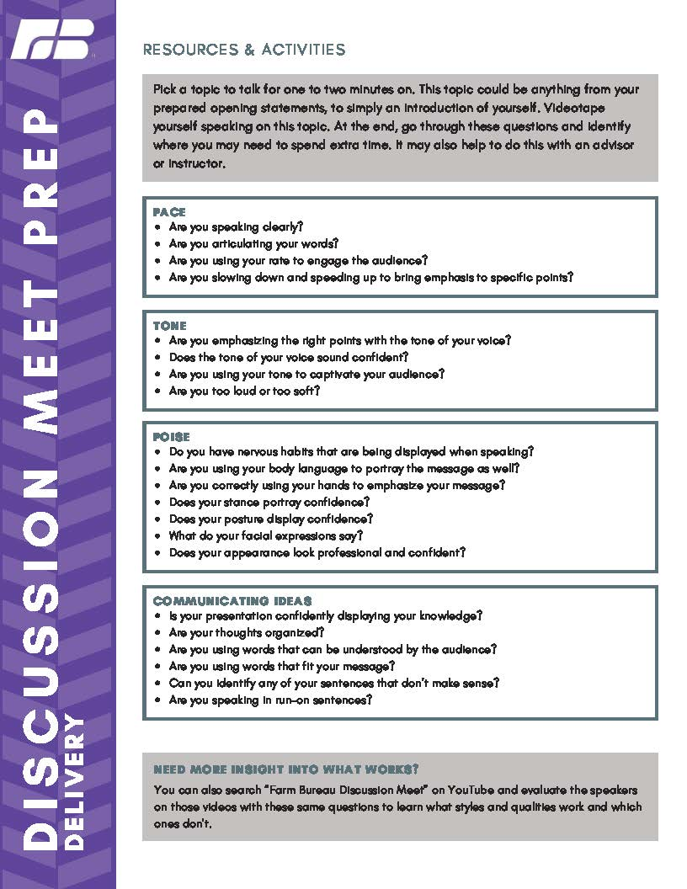
Preparation Worksheets & Activities

Slide 18
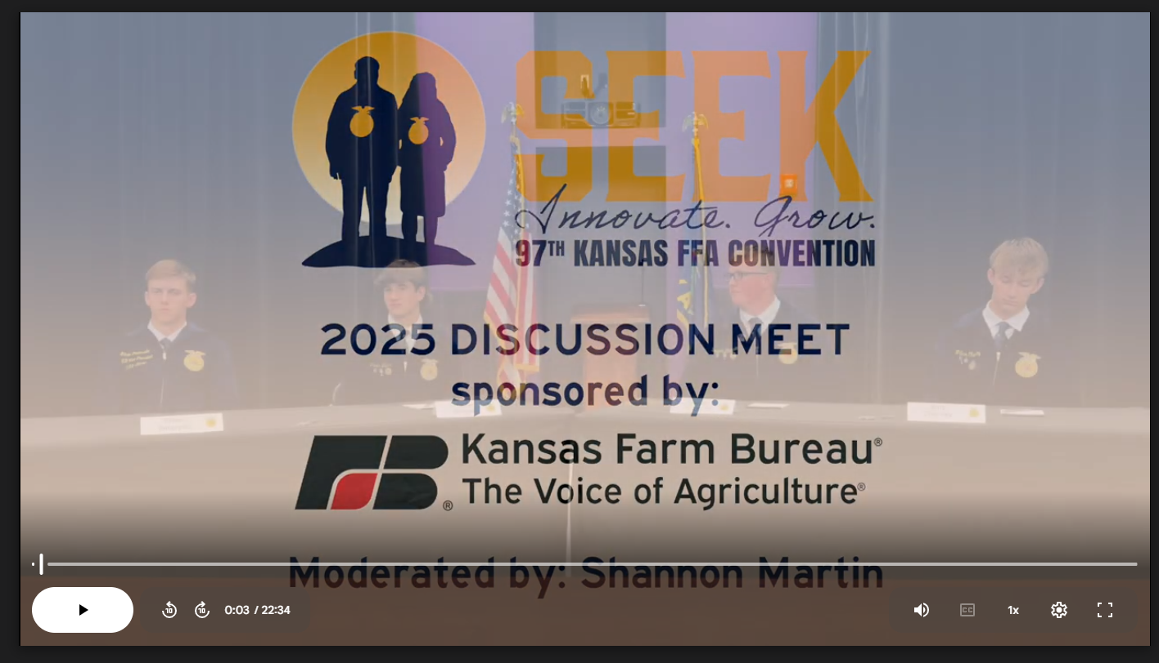
Past Competition Videos

Slide 19
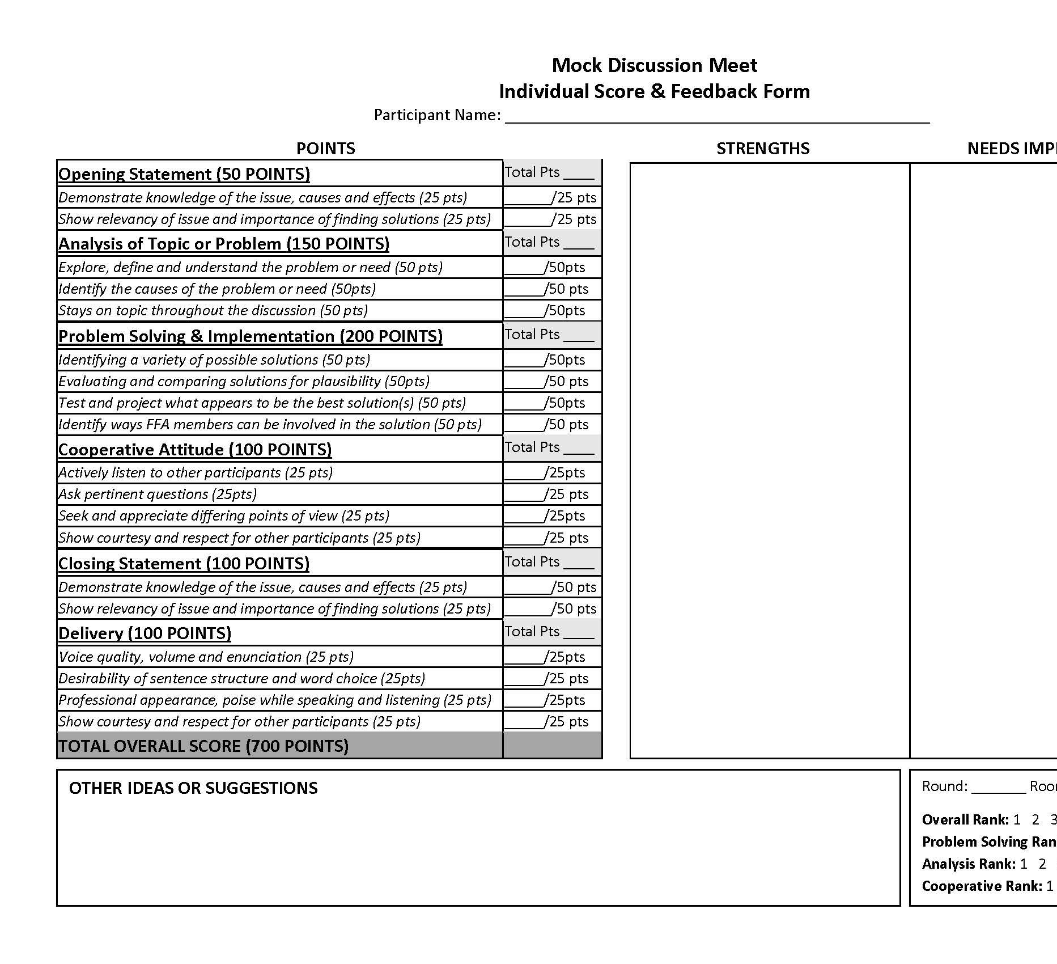
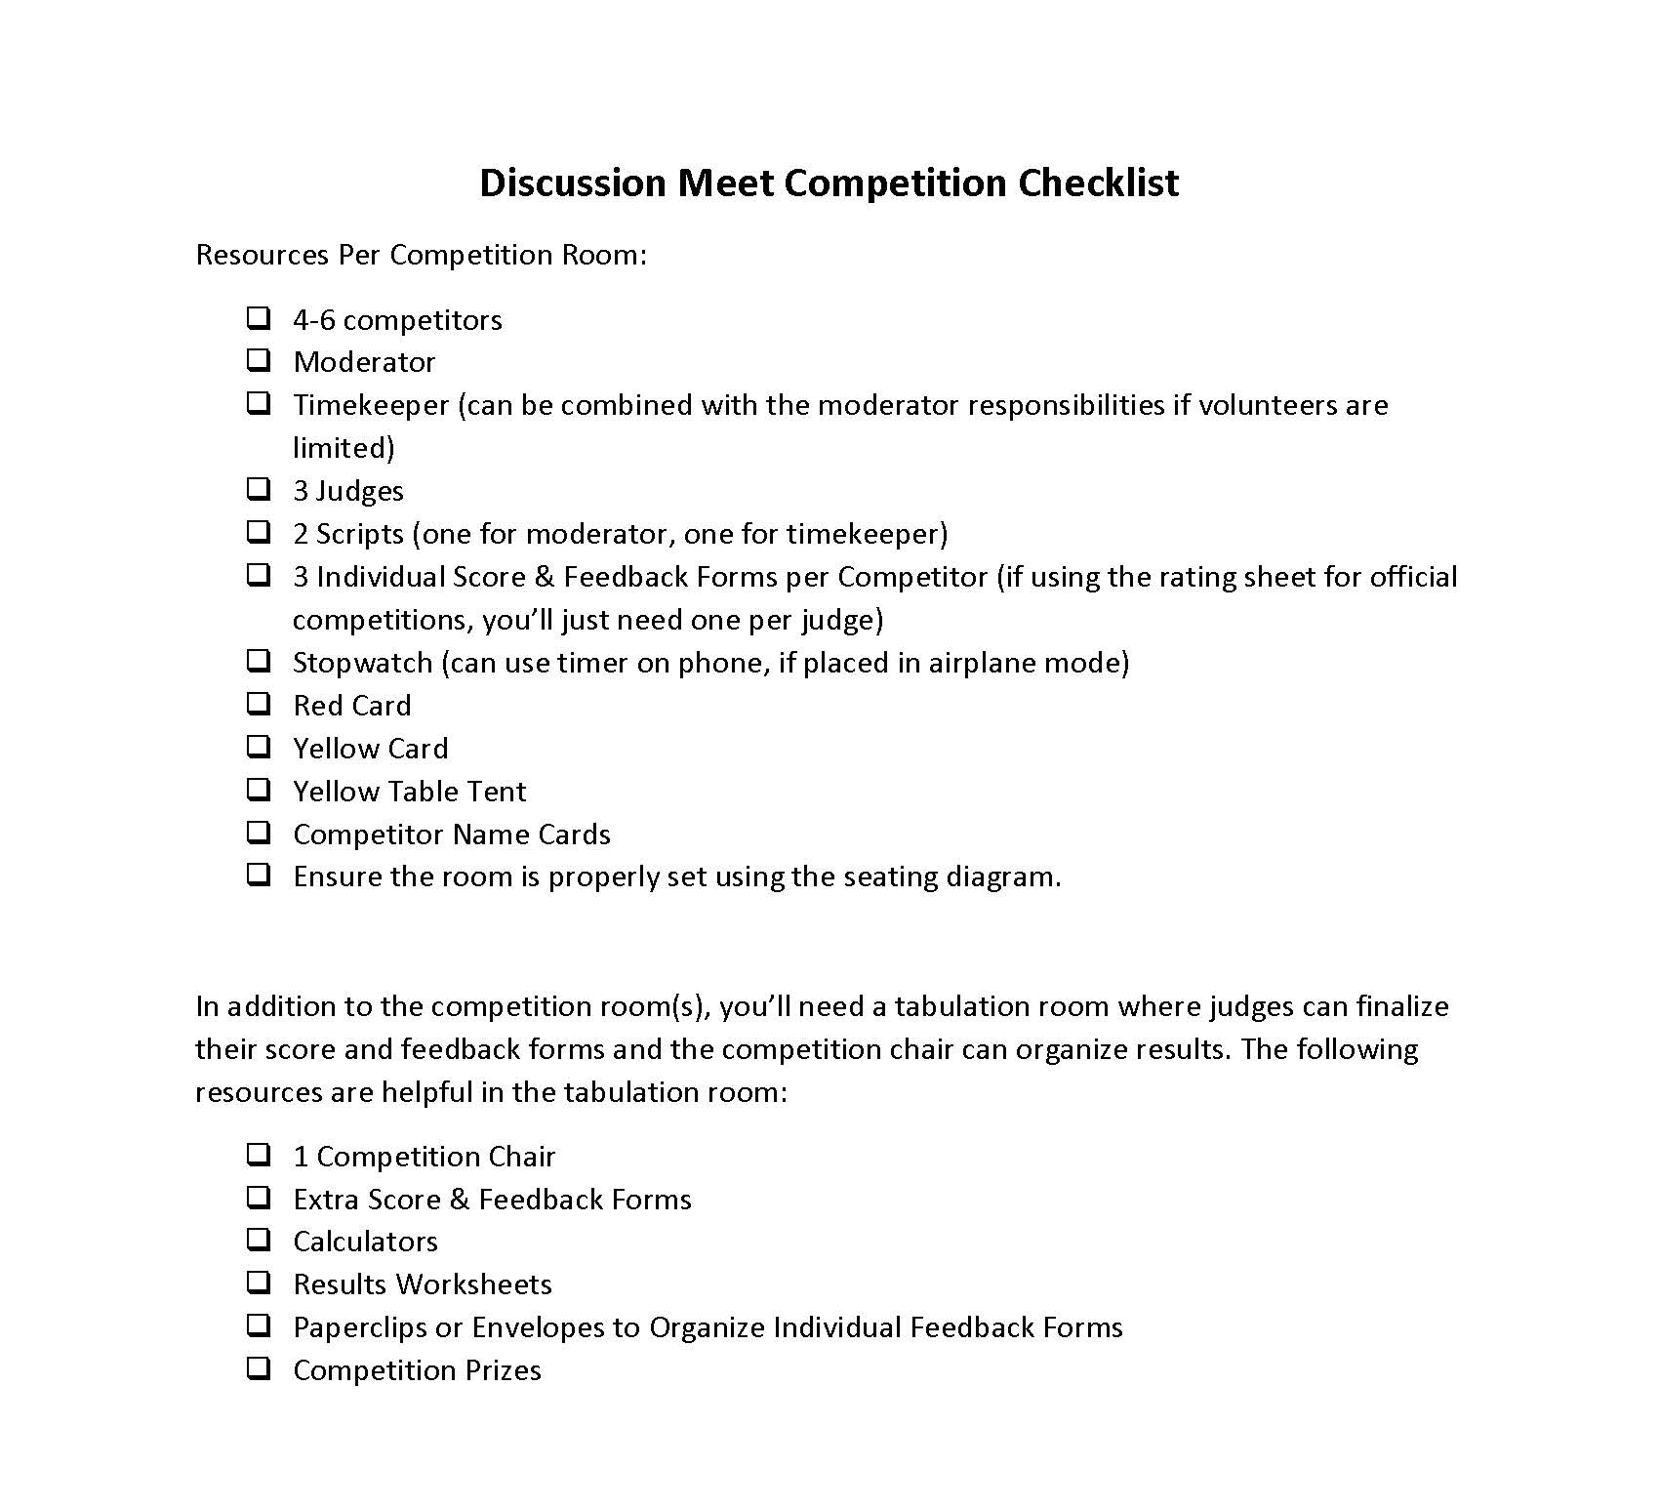
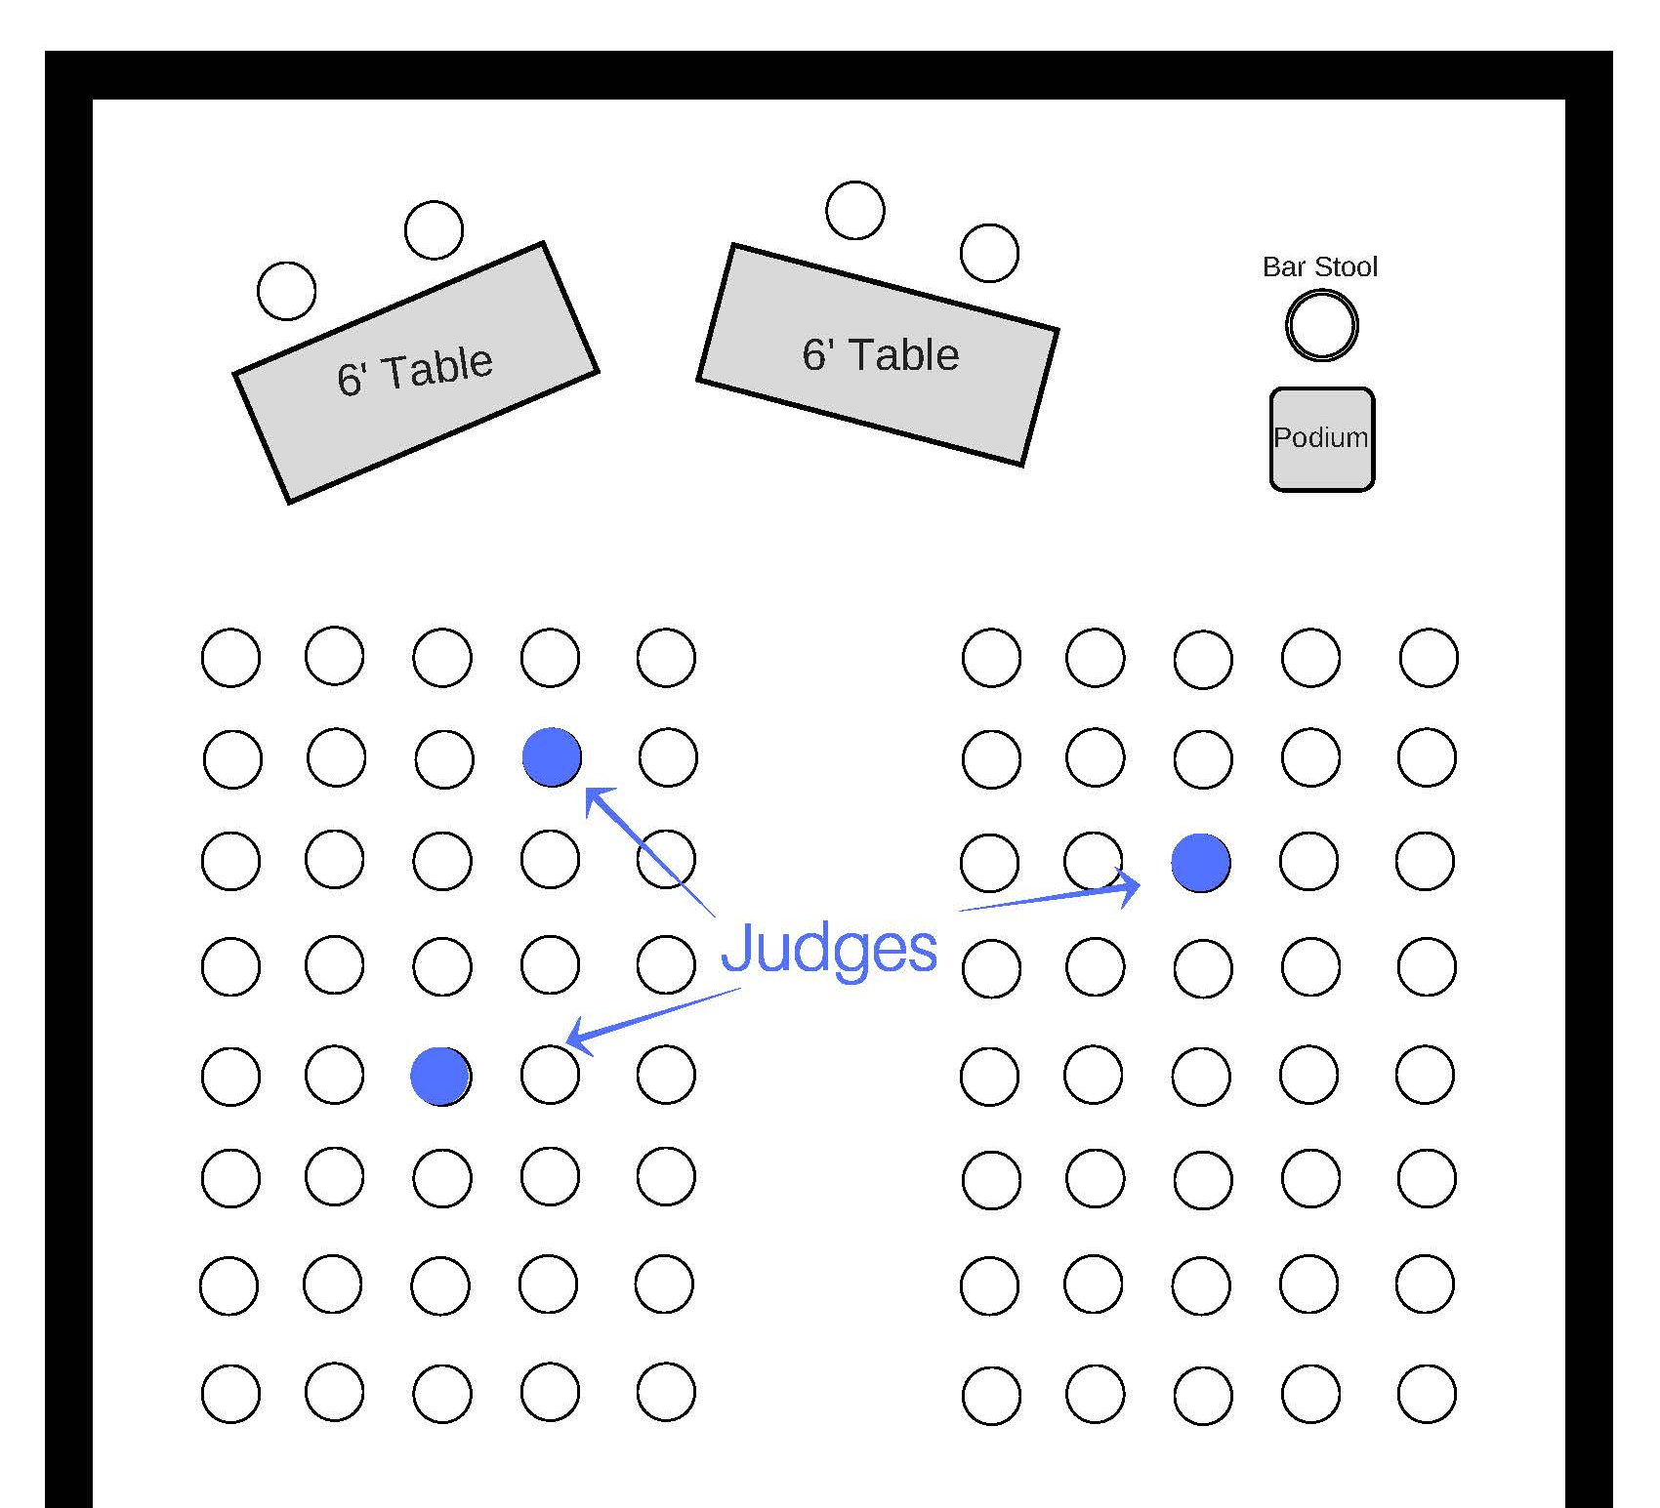
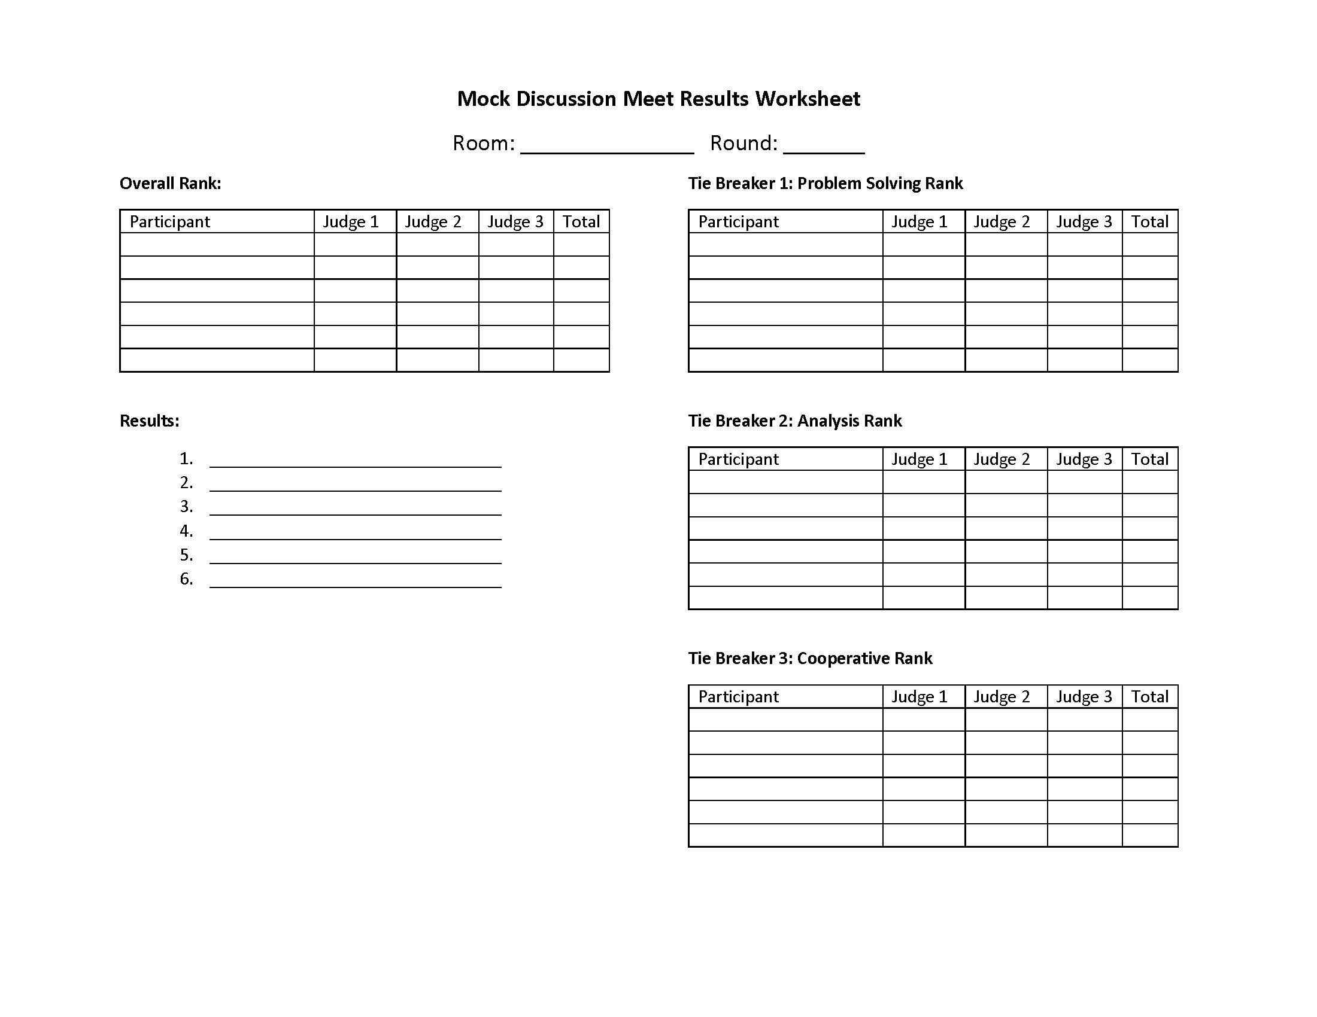
Local/Mock Competition Resources

Slide 20
Q & A

Slide 21
Kansas Farm Bureau www.kfb.org/ffa
2025-26 Competition Dates
Northeast: December 10, 2025 (Perry)
Southwest: January 7, 2026 (Garden City Community College)
Northwest: January 26, 2026 (Hoxie)
East Central: February 9, 2026 (Burlington)
North Central: March 4, 2026 (Junction City)
South Central: March 11, 2026 (Cheney)
Southeast: March 25, 2026 (Caney)
Lauren Gabriel
gabriell@kfb.org
785-587-6124

