Slide 1
Notes:
This PowerPoint was developed to be a resource for you. Our goal is to help you communicate about GMOs in an easy-to-understand and transparent way. We designed this presentation for you with this in mind.
The first section of the presentation provides background information on GMOAnswers.com – who we are, what we do and the resources we provide. The second section covers common misconceptions and the basics and science behind GMOs.
Please feel free to tailor the presentation for your audience and specific needs. We hope this guide will help you when communicating about GMOs.

Slide 2
Notes:
GMO Answers was created to do a better job answering consumers’ questions — no matter what they are — about GMOs. The biotech industry stands 100 percent behind the health and safety of the GM crops on the market today, but we acknowledge that we haven’t done the best job communicating about them – what they are, how they are made and what the safety data says. GMO Answers is the beginning of a new conversation among everyone who cares about how our food is grown.
GMO Answers represents a shift in how we communicate about agriculture. Instead of repeating just the facts and science, we must acknowledge the skepticism; show that we’re listening; and respond to questions and concerns in an open, transparent, direct and conversational manner.
GMO Answers is sponsored by the members of the Council for Biotechnology Information: BASF, Bayer CropScience, Dow AgroSciences, DuPont Pioneer, Monsanto Company & Syngenta.

Slide 3
Notes:
Our website, GMOAnswers.com, is a direct pipeline for consumers to receive answers to their questions about GMOs, agriculture and how our food is grown. To date we’ve provided hundreds of answers. The GMO Answers team works with nearly 200 independent and company experts to directly respond to consumer questions.

Slide 4
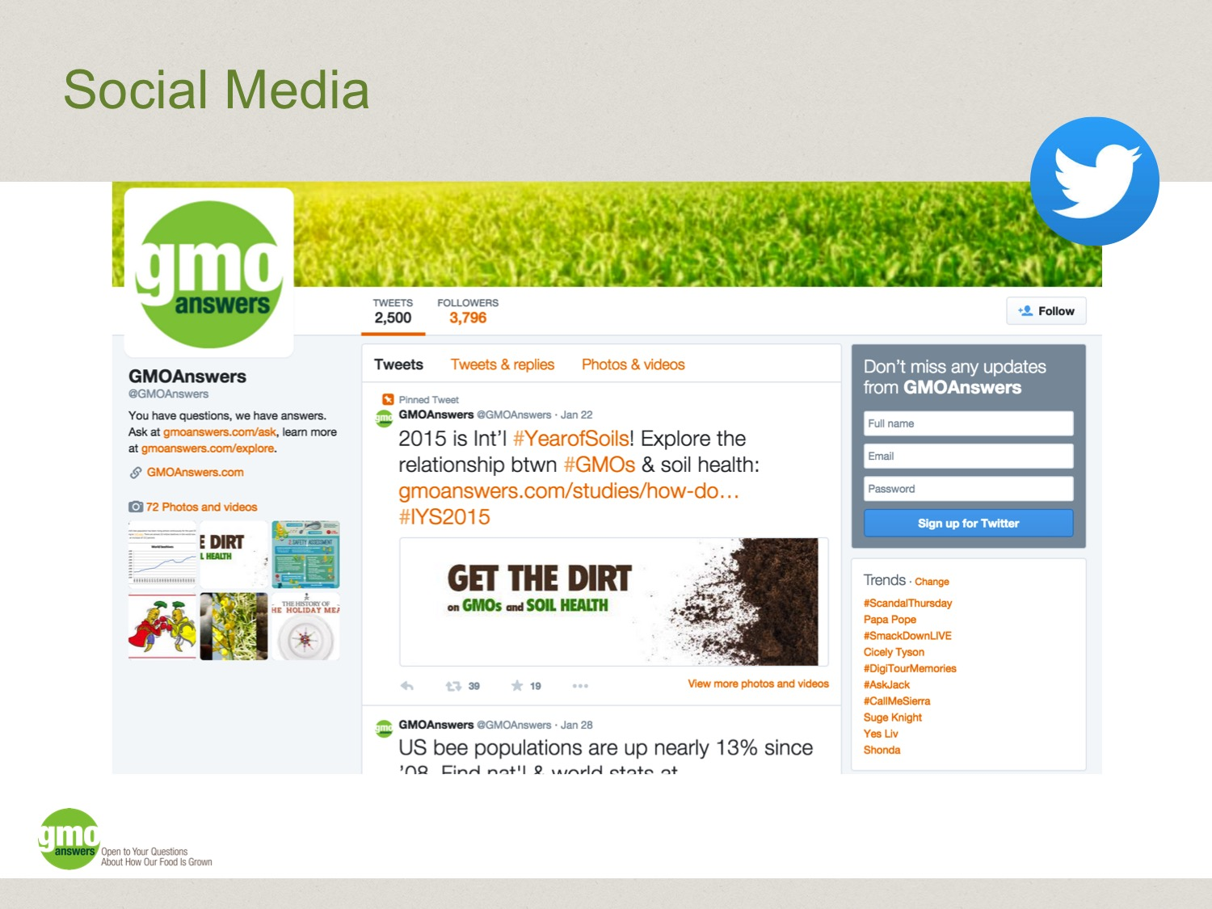
Notes:
The GMO Answers team also leverages several social media channels to engage with consumers and direct them to expert responses on GMOAnswers.com that may address some of their questions.
Twitter is our main social platform. Through Twitter, we are able to have one-on-one conversations with people who have questions about GMOs and provide them with answers that they can verify – linking back to experts’ responses on GMOAnswers.com or other credible sources of information.

Slide 5
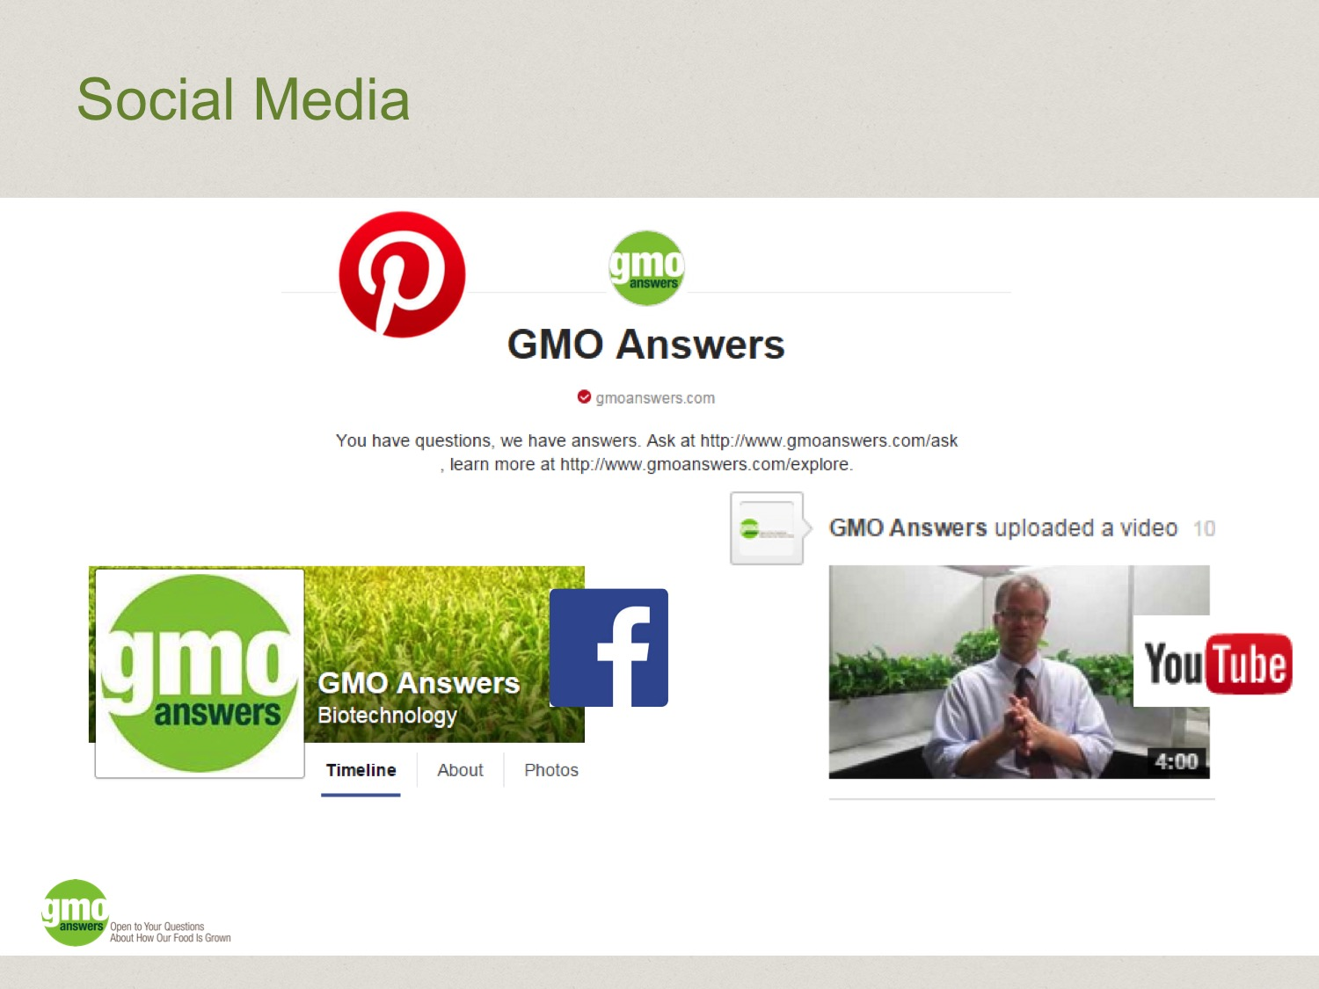
Notes:
We also use Facebook to broadcast interesting and thought-provoking information about GMOs and biotechnology. Our audience is a mix of pro-GMO, anti-GMO and those in the middle searching for more information.
In addition, YouTube and Pinterest are used to share visual GMO information to help counter inaccurate information that’s shared online.

Slide 6
Notes:
GMO Answers is a rich resource for information about GMOs and biotechnology in agriculture. Our educational resources page has materials that can be downloaded, printed and shared. Go to www.GMOAnswers.com/educational-resources.
Additionally, GMO Answers posts images to our Pinterest page, which makes them easily findable and shareable.

Slide 7
Notes:
We’ve developed Visual Mythbusters, which are simple, bright, bold images that tackle myths and misconceptions about GMOs. These purposely contain small amounts of information so that viewers can take in all of the information on a Visual Mythbuster in a just few seconds. Visual Mythbusters are designed to tackle long-standing misinformation or address the latest viral GMO meme.

Slide 8
Notes:
This section of the presentation is based on our October 2014 series: Get to Know GMOs. The content in the following slides is drawn directly from our website. You can find the full series here: https://gmoanswers.com/studies/october-get-know-gmos-month
The following slides will help you get to know and talk about GMOs. From correcting common misconceptions to providing basic information – like what a GMO is, to how GMOs are tested and regulated, this section was developed to make information about GMOs easier for everyone to understand.

Slide 10
Notes:
Many people are confused about what a GMO is. We often come across a wide variety of misinformation and misconceptions on social media. Here are the top five misconceptions we see most frequently:
#1: If it’s extra-large, seedless, looks weird, tastes bad and feels squishy – it must be a GMO.
#2: GMOs aren’t safe and they’re only tested by the companies making them.
#3: There is animal DNA in GMOs.
#4: GMOs have pesticides injected into them.
#5: GMO companies force farmers to grow their crops, or sue farmers if GMO seeds or pollen blow into their fields
The following five slides will correct these misconceptions.

Slide 11
Notes:
Myth no. 1 - If it’s extra-large, seedless, looks weird, tastes bad, and feels squishy – it must be a GMO.
We see lots of tweets about strange-looking strawberries on Twitter. Just because a strawberry is extra-large or shaped kind of funny, that doesn’t mean it’s a GMO.
In fact, currently there are only eight commercially grown crops in the United States that may be genetically modified. These crops are:
Alfalfa – used for animal feed
Canola - canola oil for cooking; also used in animal feed
Corn - field corn used in animal feed, processed food ingredients and ethanol; sweet corn for our consumption
Cotton – cotton clothing; cotton oil for cooking; animal feed
Papaya – our consumption
Soybeans – processed as food ingredients; used in animal feed; other industrial uses
Squash – our consumption
Sugar beets – sugar; used in animal feed
Two additional crops were recently approved, but are not yet available in markets:
Innate potato – its characteristics are low bruising and black spot, non-browning and low acrylamide
Arctic Golden and Granny Smith apples – its characteristic is non-browning

Slide 12
Notes:
Myth no. 2 - GMOs aren’t safe and they’re only tested by the companies making them.
GMOs are the most regulated and tested product in agricultural history. It takes up to 13 years and more than $136 million to bring one trait to market.
In the U.S., GM crops are reviewed by at least two, and sometimes three, federal regulatory agencies, depending on the product – USDA, FDA and sometimes EPA.
According to the European Commission, “The main conclusion after more than 130 research projects, covering a period of more than 25 years of research and involving more than 500 independent research groups, is that biotechnology, in particular GMOs, are not per se more risky than E.G. conventional plant-breeding technologies.“ (A Decade of EU-Funded GMO Research 2001 – 2010. (2010). Retrieved from http://ec.europa.eu/research/biosociety/pdf/a_decade_of_eu-funded_gmo_research.pdf.)
U.S. National Academy of Sciences (NAS), United Nations Food and Agriculture Organization (FAO), World Health Organization (WHO), American Medical Association (AMA), the American Association for Advancement of Science (AAAS) and many others have concluded that GM crops do not pose more risks to people, animals or the environment than any other foods. (http://www.ilsi.org/Pages/Safety%20Assessment%20of%20Genetically%20Modified%20Foods.aspx)
Additionally, you can research hundreds of independent studies about GMOs available at Biofortified.org. (Frank N. Foode™ is the official mascot of Biofortied.org)

Slide 13
Notes:
Myth no. 3 - There is animal DNA in GMOs.
Where does this myth come from? Once upon a time there was an experimental tomato that contained a gene from the winter flounder to increase the tomato's resistance to frost, but that tomato was never commercialized.
No commercial GM crops on the market today contain “animal genes.”
But, did you know that about 60 percent of the genes in plants have very similar copies in animals?
DNA from any source is made up of the same four basic building blocks (nucleotides): adenine (A), cytosine (C), thymine (T) and guanine (G). DNA that comes from a plant, a microbe, or an animal has these same four building blocks.
All food contains DNA, and our bodies breakdown DNA the same way regardless of where it comes from – plant or animal.

Slide 14
Notes:
Myth no. 4 - GMOs have pesticides injected into them.
Some (but not all) GMO crops have been genetically engineered to fight off pests, but a syringe is not used to inject pesticides directly into a plant or seed.
For example, insect resistant seeds contain a Bt (Bacillus thuringiensis) protein, a common soil bacterium, which is toxic only to very specific insects, but not to humans, mammals or non-target insects.
The Bt in these seeds reduces pest damage and reduces the need for as many pesticide applications.
Did you know:
Bt has been used for more than 100 years in organic farming as a pesticide spray and is still being used today.
Bt is only toxic to certain insects that have a particular receptor in their guts – humans and most other insects do not have this receptor; therefore, there is no impact on us, mammals or non-target insects.

Slide 15
Notes:
Myth no. 5: GMO companies force farmers to grow their crops, or sue farmers if GMO seeds or pollen blow into their fields.
Farmers choose what seeds to grow based on:
What is best for their farms
Local growing environments, and
Consumer demand
Many farmers successfully grow, on the same farm, all three of these crops: organic, non-GMO (“conventional”) and GMOs
Additionally, “urban legends also claim that biotech seed companies troll the country, suing farmers for patent infringement when their crops have been accidentally cross pollinated by a neighbor’s genetically engineered plants.
But not a single known case of this has actually occurred.
The myth is spread by misrepresenting cases, such as that of Canadian farmer Percy Schmeiser, who claimed he was sued when patented Roundup Ready canola plants were discovered on his farm.
But the Canadian court that heard his case concluded that Schmeiser had intentionally planted canola seeds containing the patented Roundup Ready gene and was not merely a victim of unintended cross pollination.” (Greg Conko, Competitive Enterprise Institute)

Slide 16
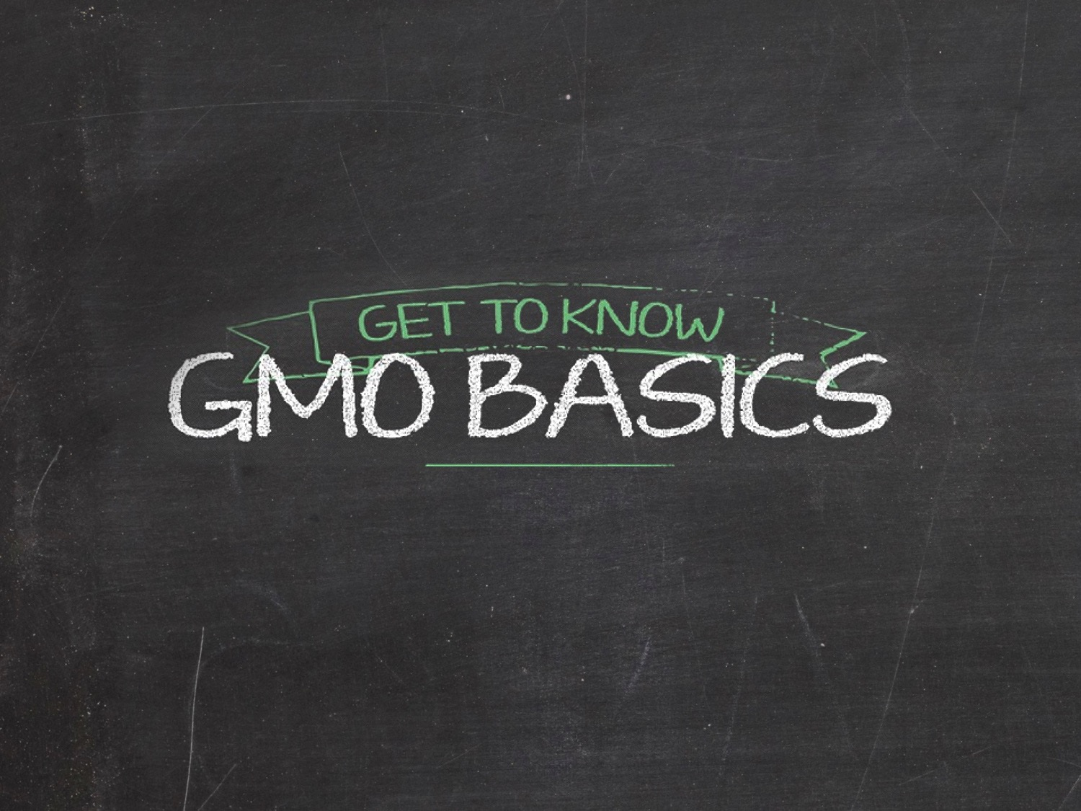

Slide 17
Notes:
What is a GMO?
GMOs are crops developed with genetic engineering, a more precise breeding technique, that enables someone to take individual traits found in nature and transfer them to another plant, or make changes to an existing trait in a plant.
You may have also heard of “agricultural biotechnology” or “biotech seeds”. These are terms that may be used to refer to the same thing – a genetically modified organism (GMO).
The eight commercial crops available today – alfalfa, canola, corn (field and sweet), cotton, papaya, soybeans, squash and sugar beets – have been created to have special traits:
Disease resistance
Herbicide resistance
Insect resistance
Drought tolerance
Improved nutrition
Two additional crops were recently approved but are not yet available in the market:
Innate potato – its characteristics are low bruising and black spot, non-browning and low acrylamide
Arctic Golden and Granny Smith apples – its characteristic is non-browning

Slide 18
Notes:
How did we get here?
Farmers have been intentionally changing the genetic makeup of all domesticated crops for about 10,000 years. Every fruit, vegetable and grain that is commercially available today has been altered by human hands, including organic and heirloom seeds.
This process began approximately 10,000 years ago and farmers have implemented new techniques ever since.

Slide 19
Notes:
Where would we be without plant breeding?
These pictures are examples of nature’s original fruits and vegetables.
Without plant breeding of any kind, we would have corn kernels that you would have to crack open with a rock; a banana that is difficult to peel and full of seeds; and broccoli that no amount of cheese could make edible.

Slide 20
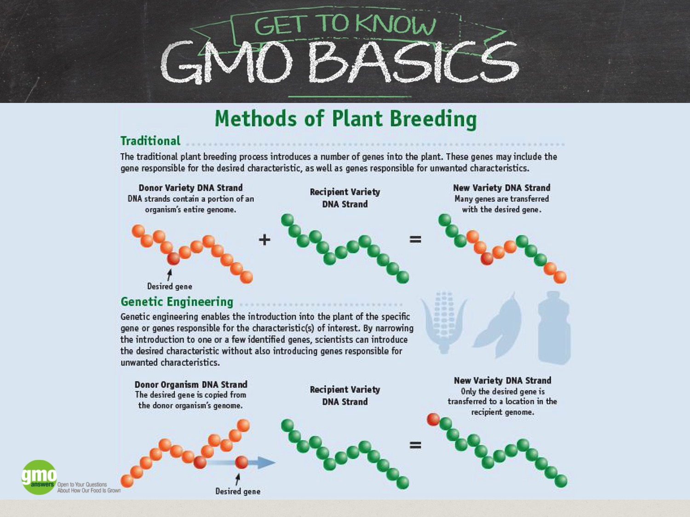
Notes:
In the late 20th century, advances in technology enabled us to expand the genetic diversity of crops through genetic engineering; a major result of this was GM seeds.
Curious about what different types of breeding look like at the DNA level?
This infographic from the U.S. Food and Drug Administration uses segments of DNA to demonstrate how genetic engineering compares to traditional breeding.
While genetic engineering is the latest technique used in the long evolution of plant breeding, it differs from other techniques by enabling specific, more predictable changes to be made to a plant.

Slide 21
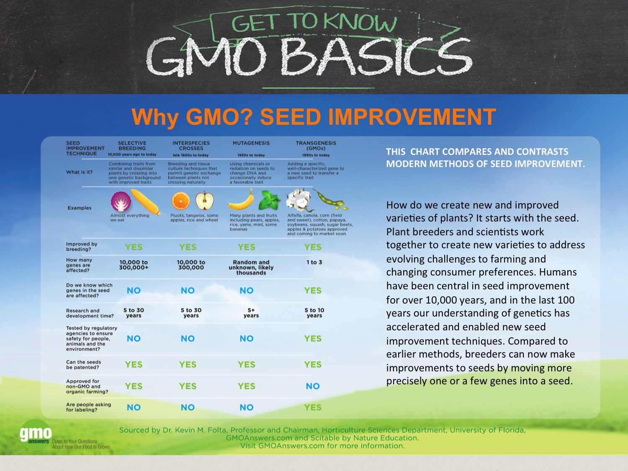
Notes:
It is important to note that there are other methods of plant breeding beyond traditional breeding and genetic engineering which you can see in this infographic.
Here you’ll see different seed improvement techniques compared: selective (aka “traditional”) breeding, interspecies crosses, mutagenesis and transgenesis (GMO).
All of these techniques are used today.
Even though genetic engineering is a more precise breeding technique compared to the other three, only GMOs are required to go through regulatory approval before they are commercialized and are excluded from use in organic agriculture.

Slide 22
Notes:
Now that we’ve explored the various plant breeding methods, why do we develop and use GMOs?
GMOs are created to achieve a specific, desired trait. For example, resistance to an insect or a specific herbicide or to enhance nutrition, as noted in this table. (reference examples in table)
It is important to remember that farmers choose seeds that are best for their farms and businesses. They determine which seeds, inputs and management practices are best for their land, business and growing conditions.
There are a variety of seed options for farmers to choose from - including GM, conventional and organic. (insert applicable examples/personal during presentation – if possible)

Slide 23
Notes:
How exactly is a GMO made?
GMOs can have one or a few genes added, moved or turned off to achieve the desired trait. This video explains how genetic engineering was used to make the Hawaiian papaya resistant to the deadly papaya ring spot virus.
https://www.youtube.com/watch?v=2G-yUuiqIZ0 (Running time: 5:32)
NOTE TO PRESENTER: In case showing the video in this slide is not an option, please use the static images and information in slide 24 in lieu of this slide.

Slide 24
Notes:
ALTERNATIVE TO SLIDE 23 IF VIDEO NOT AVAILABLE:
How exactly is a GMO made?
GMOs can have one or a few genes added, moved or turned off to achieve the desired trait. These pictures help explain how genetic engineering was used to make the Hawaiian papaya resistant to the deadly papaya ring spot virus.
(The following numbered text corresponds with the above numbered pictures.)
First, in 1985 Farmers and Researchers decided that genetic engineering was the best technique to use to solve the problem.
Second, Researchers identified and isolated a PRSV gene from the virus itself.
Third, a process called “transformation” (inserting a copy of genetic material for a specific trait into a plant’s cells) was used to get the PRSV gene into the papaya plant DNA.
Finally, 17 plants were successfully transformed and produced the protein that made the plant resistant to PRSV – this result is similar to a flu shot that makes us resistant to the flu. It then took seven years of testing for the seeds to be approved.
In 1998, harvesting of the new GM papaya began. By 2001 the industry had more than 46 million pounds of fresh papaya.
As of 2010, 70 percent of Hawaii’s papaya industry is GM Rainbow papaya. This fruit has been grown and consumed in the U.S. for more than a decade.

Slide 25
Notes:
Who around the world grows GMOs?
From South Africa to China to the EU, there is a global community of farmers growing biotech crops.
According to the International Service for the Acquisition of Agri-Biotech Applications (ISAAA), in 2014 there were 70 countries around the world that grew, imported and/or tested GMO crops in field trials. The newest country to cultivate a GMO crop is Bangladesh, where farmers are growing Bt eggplant.
When the 4 billionth biotech acre was planted in April 2014, Spanish farmer Jose Luiz Romeo was asked why he grows GMOs (https://truthabouttrade.org/2014/04/03/planting-the-four-billionth-acre-of-biotech-crops-in-the-world/) and said, "Although GM crops may be common, they are anything but ordinary. They are extraordinary plants that allow the world’s farmers to grow more food on less land."
As Fourat Janabi points out in his post on GMOAnswers (https://gmoanswers.com/studies/random-thoughts-biotech), "Since 1961, we’ve increased yield by 300%, and only had to increase our land use by 12% to do so...By 2050, we will need to almost double yield without an increase in land usage."

Slide 26
Notes:
How do we make sure that GMOs are safe for use and consumption?
Today’s GM products are the most researched and tested agricultural products in history.
GMO crops are studied extensively to make sure they are safe for people, animals and the environment
GM seeds take an average of $136 million and 13 years to bring to market because of research, testing and regulatory approvals conducted by government agencies in the United States and around the world.
In the U.S., GM crops are reviewed by at least USDA and FDA and sometimes EPA depending on the trait.
In the next few slides, we’ll talk more about the safety of GMOs.

Slide 27
Notes:
GMO Safety: Safe to Eat
GMOs available today are as safe as their non-GMO counterparts.
They do not cause new allergies, cancer, infertility, ADHD, autism or any other diseases or conditions.
U.S. National Academy of Sciences (NAS), United Nations Food and Agriculture Organization (FAO), World Health Organization (WHO), American Medical Association (AMA), the American Association for Advancement of Science (AAAS) and many others have concluded that GM crops do not pose more risks to people, animals or the environment than any other foods. http://www.ilsi.org/Pages/Safety%20Assessment%20of%20Genetically%20Modified%20Foods.aspx
According to the European Commission, “The main conclusion after more than 130 research projects, covering a period of more than 25 years of research and involving more than 500 independent research groups, is that biotechnology, in particular GMOs, are not per se more risky than E.G. conventional plant-breeding technologies. “ (A Decade of EU-Funded GMO Research 2001 – 2010. (2010). Retrieved from http://ec.europa.eu/research/biosociety/pdf/a_decade_of_eu-funded_gmo_research.pdf.)
With regard to allergies, researchers developing new GM crops deliberately avoid using potentially allergenic genes from milk, eggs, wheat, fish, shellfish, tree nuts, peanuts and soy – the eight major foods accounting for 90 percent of all food allergy cases in the United States.
In addition, researchers compare new GM crops under development to a database of hundreds of known allergens and toxins to avoid possible links.

Slide 28
Notes:
GMO Safety: Safe for the environment
In addition to being thoroughly tested to ensure GMOs don’t negatively impact the environment, biotech crops have actually reduced agriculture’s environmental footprint:
The increased yield through improved pest control on current land prevents further deforestation and protects ecosystems
Making fewer pesticide applications
And, no/reduced tillage with GM HT technology means less tractor fuel consumption and emissions
Because of these benefits, “In 2013, the permanent CO2 savings from reduced fuel use associated with GM crops was 62 billion pounds. This is equivalent to removing 12.4 million cars from the road for a year.” – (Graham Brookes, Agricultural Economist, PG Economics Ltd)

Slide 29
Notes:
GMO Safety: Safe to Grow
When testing, researchers look for any difference between the GM and non-GM plants to make sure the GM variety grows the same as the non-GM variety.
They are also tested to make sure they do not unintentionally harm non-target, beneficial insects, like honey bees and ladybugs.

Slide 30
Notes:
What does the future of GMOs look like?
Genetic engineering has many applications other than food or the GMO crops currently on the market.
Healthcare: a GM tobacco plant has been used to develop a treatment for the Ebola virus, and most human insulin already is genetically engineered. (top left)
Save our OJ!: GM citrus could help fight citrus greening, a plant disease that is devastating the citrus industry in the U.S. (bottom left)
Biofortification: the Danforth Plant Science Center is developing BioCassava Plus - more nutritious, higher yielding and more marketable cultivars of cassava, the primary source of calories for 250 million Africans. (top right)
Restore extinct plant species: the State University of New York (SUNY) College of Environmental Science and Forestry (ESF) has genetically modified the American Chestnut tree to withstand the blight that has nearly wiped out this iconic hardwood tree in the United States. (bottom right)

Slide 31
Notes:
Looking for More Information?
You can visit GMOAnswers.com to learn more about GMOs and ask your questions.
You can also find us on Twitter, Facebook, Pinterest, YouTube and Google+
Thank you

