Slide 1
Cow Digestive System

Slide 2
Monogastric and ruminant digestive systems are different.
Monogastric systems have one true stomach, while ruminants have a multi-chambered stomach.

Slide 3
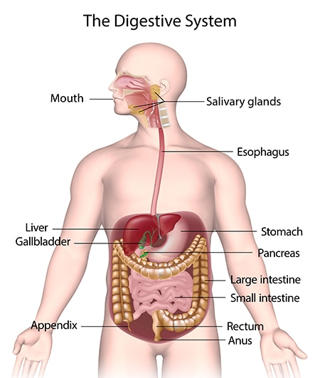

Slide 4
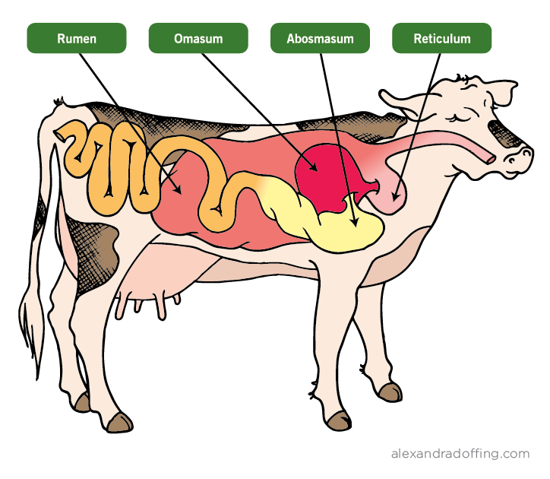

Slide 5
Label one bag “monogastric“ to represent a human stomach.
Label four bags with the name of each chamber of the cow’s stomach.
Rumen, Reticulum, Omasum, Abomasum
3. Put half a piece of bread into all plastic baggies.

Slide 6
4. In the “human” bag add 1/2 cup of orange juice.

Slide 7
5. Put the following materials in each of the four cow bags:
Rumen: 1/2 cup yogurt (Fermented)
Reticulum: 1/4 cup of water (Removes objects)
Omasum: 5 paper towels (Pulls moisture out)
Abomasum: 1/2 cup orange juice (Acid)

Slide 8
6. Put half of the grass into the human bag, seal and set aside.

Slide 9
7. Put the rest of the grass and in the rumen bag with the yogurt to represent the fermentation stage.
Knead for 2 minutes.

Slide 10
8. Remove the grass and put it and the buttons into the Reticulum bag with the water to remove objects and knead for 2 minutes.

Slide 11
9. Move the grass mixture into the omasum bag with the paper towels to remove moisture and knead for 2 minutes.

Slide 12
10. Remove the grass and move it into the abomasum bag with orange juice for fermentation and knead for 2 minutes.

Slide 13
11. Knead the grass in the human bag for two minutes.

Slide 14
12. Compare the grass in the human and cow stomachs.

Slide 15
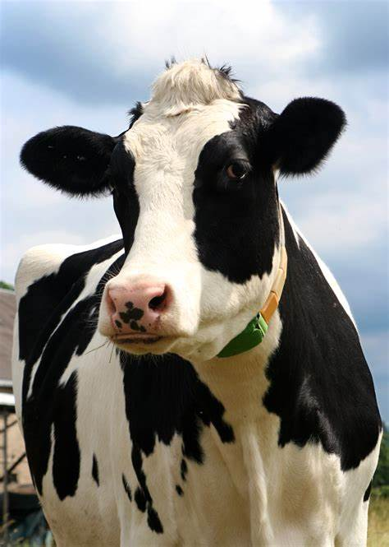
Which stomach was better at breaking down the grass?

