Slide 1
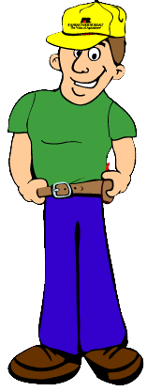

A Farmer’s
Tool Chest of Jobs
Farmers have to know how to do many different jobs.
Notes:
WELCOME TO MY TOOL CHEST OF JOBS! I’M A KANSAS FARMER AND I HAVE TO BE ABLE TO DO MANY DIFFERENT JOBS ON MY FARM.

Slide 2
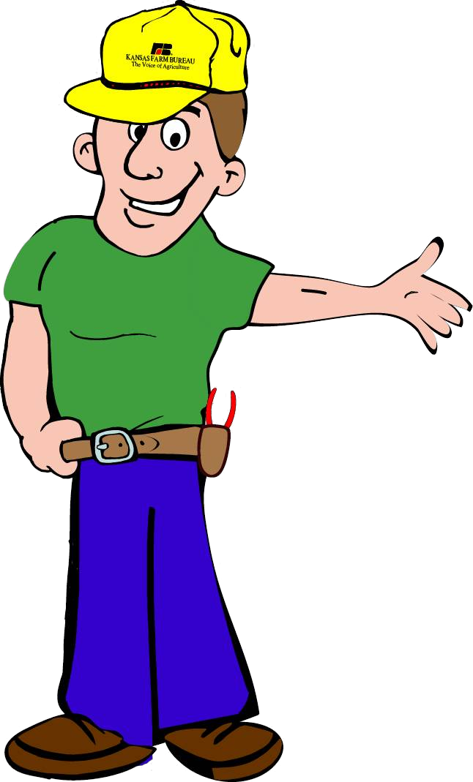
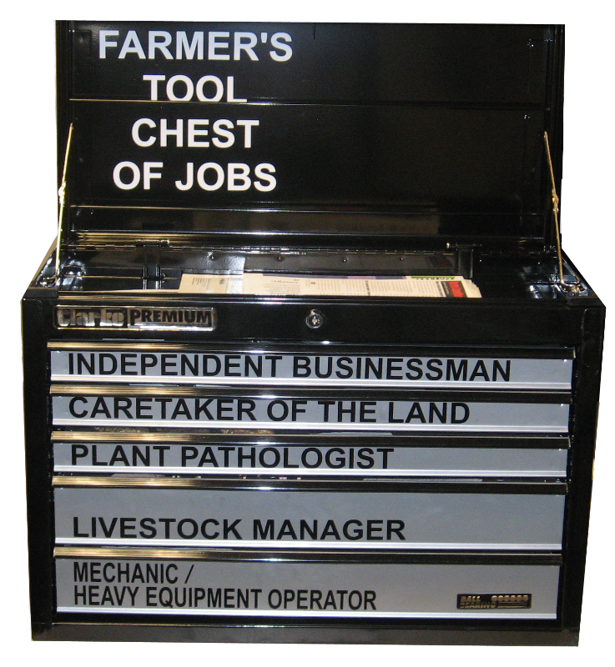
Notes:
I HOPE YOU’VE BEEN ABLE TO GO THROUGH MY TOOLBOX AND LEARN ABOUT THE DIFFERENT TYPES OF JOBS I DO ON MY FARM…EVERYTHING FROM BEING A WEATHERMAN AND PLANT SCIENTIST TO A MECHANIC AND INDEPENDENT BUSINESSMAN.

Slide 3
Test your knowledge by answering the following questions with me!
Notes:
LET’S TEST YOUR KNOWLEDGE BY ANSWERING THESE QUESTIONS.

Slide 4
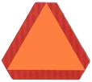

What does a farmer put on the back of his tractor to tell you that he is moving slowly?
Notes:
WHAT DOES A FARMER PUT ON THE BACK OF HIS TRACTOR TO TELL YOU THAT HE IS MOVING SLOWLY?NOT A TIRE…..NOT A STOP SIGN…..AND NOT A LICENSE PLATE

Slide 5

Farmers are… heavy equipment operators.
A slow moving vehicle emblem, or an SMV, is used when farm equipment is going less than 25 miles per hour on a public road. Farmers obey traffic laws when using farm equipment.
Notes:
A SLOW MOVING VEHICLE EMBLEM OR SMV IS USED WHEN FARM EQUIPMENT IS GOING LESS THAN 25 MILES PER HOUR ON A PUBLIC ROAD. FARMERS OBEY TRAFFIC LAWS WHEN USING FARM EQUIPMENT.

Slide 6
Why do farmers use ear tags when taking care of livestock?
It is a form of jewelry, like an earring, for the animal.
Ear tag is a game livestock like to play at recess.
It helps the farmer keep good records about the animals.
Notes:
WHY DO FARMERS USE EAR TAGS WHEN TAKING CARE OF LIVESTOCK?
IT IS A FORM OF JEWELRY, LIKE AN EARRING, FOR THE ANIMAL.
EAR TAG IS A GAME LIVESTOCK LIKE TO PLAY AT RECESS.
IT HELPS THE FARMER KEEP GOOD RECORDS ABOUT THE ANIMALS.

Slide 7
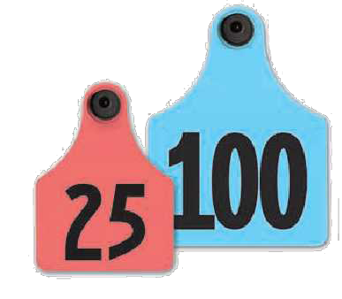
Farmers are… livestock managers.
Ear tags help farmers take care of their livestock by providing a number to each animal. This number helps the farmer keep records of each animal’s health.
Notes:
EAR TAGS HELP FARMERS TAKE CARE OF THEIR LIVESTOCK BY PROVIDING A NUMBER TO EACH ANIMAL. THIS NUMBER HELPS THE FARMER KEEP RECORDS OF EACH ANIMAL’S HEALTH.

Slide 8
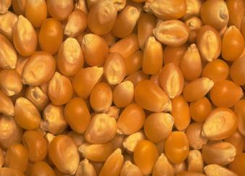
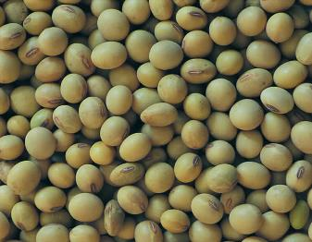
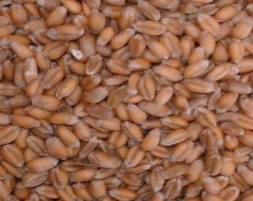
Match the crop to the correct picture.
Soybeans
Wheat
Corn
Notes:
MATCH THE CROP LISTED ON THE LEFT TO THE CORRECT PICTURE ON THE RIGHT.
GOOD JOB!

Slide 9
Farmers are…
plant scientists.
Farmers know about many crops so they can grow the many different types of food we enjoy.
Notes:
FARMERS KNOW ABOUT MANY CROPS SO THEY CAN GROW THE MANY DIFFERENT TYPES OF FOOD WE ENJOY.

Slide 10

What does a farmer use to measure the temperature outside?
        MP3 Player
        Rain Gauge
        Ruler
        Thermometer
Notes:
WHAT DOES A FARMER USE TO MEASURE THE TEMPERATURE OUTSIDE?
IPOD
RAIN GAUGE
RULER
THERMOMETER
THE CORRECT ANSWER IS THERMOMETER. NICE WORK!

Slide 11
Farmers are… weathermen.
A farmer watches the temperature closely with a thermometer because the weather affects many of the farmer’s jobs, such as checking livestock or planting and harvesting crops.
Notes:
A FARMER WATCHES THE TEMPERATURE CLOSELY WITH A THERMOMETER BECAUSE THE WEATHER AFFECTS MANY OF THE FARMER’S JOBS, SUCH AS CHECKING LIVESTOCK OR PLANTING AND HARVESTING CROPS.

Slide 12
What kinds of computers can a farmer use to help him with his job?
A. Cell Phone
B. Global Positioning System (GPS)
C. PDA
D. Computer
E. All of the Above
Notes:
WHAT KINDS OF COMPUTERS CAN A FARMER USE TO HELP HIM WITH HIS JOB?
CELL PHONE
GLOBAL POSITIONING SYSTEM
PDA
COMPUTER
ALL OF THE ABOVE
THE ANSWER IS E, ALL OF THE ABOVE! YOU’RE DOING A GREAT JOB!

Slide 13
Farmers are… independent businessmen.
Farmers can get text messages on cell phones for market reports, use GPS for auto-steer on farm equipment, and use personal computers for record-keeping. Farmers use many kinds of computers in their work.
Notes:
FARMERS CAN GET TEXT MESSAGES ON CELL PHONES FOR MARKET REPORTS, USE GPS FOR AUTO-STEER ON FARM EQUIPMENT, AND USE PERSONAL COMPUTERS FOR RECORD-KEEPING. FARMERS USE MANY KINDS OF COMPUTERS IN THEIR WORK.

Slide 14
Nice Job!
Thanks for learning about some of the jobs I do on my farm!
And that’s not all… I’ve also got to be a water quality manager, public policy advocate, and much more!
Notes:
NICE JOB! I KNEW YOU’D DO WELL!
THANKS FOR LEARNING ABOUT JUST SOME OF THE JOBS I DO ON MY FARM. AND THAT’S JUST SCRATCHING THE SURFACE. I’VE ALSO GOT TO BE A WATER QUALITY MANAGER, PUBLIC POLICY ADVOCATE, AND MUCH MORE

Slide 15

Notes:
THANKS TO FARM BUREAU, THE STATE’S LARGEST GENERAL FARM ORGANIZATION, I’M ABLE TO DO ALL OF MY JOBS BETTER.

